Slide 1
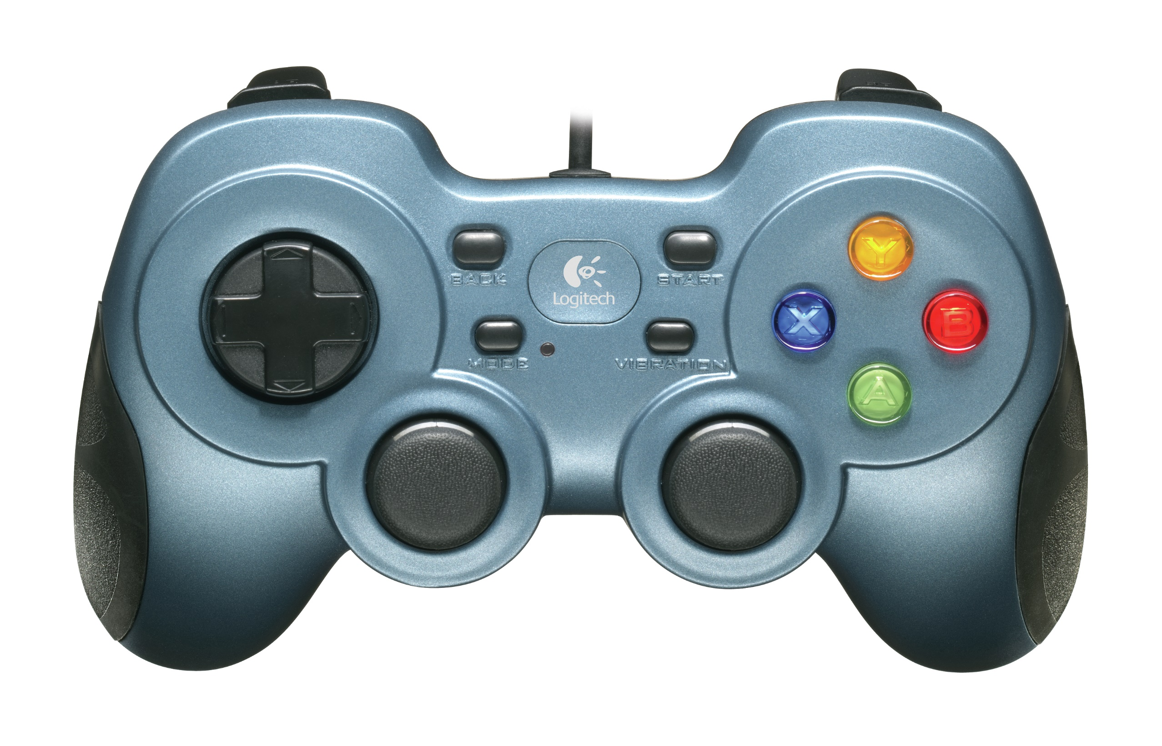
Reverse Conveyor
Ball Dunker
Tilt Bucket
Ball Release
Conveyor Belt
Drive
Arm Control

